Slide 2
Lap Around .NET 2015
2-614
Jay Schmelzer
Director Program Management
Microsoft Corp.

Slide 3




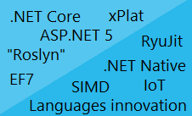







The road ahead for .NET
ASP.NET 5
.NET Core
.NET Innovation
Open Source
Cross-Platform

Slide 4

.NET 2015
WPF
Windows Forms
ASP.NET
(4 & 5)
ASP.NET Core 1.0
Universal
Windows Apps
.NET Framework 4.6
.NET Core 5
CoreCLR
.NET Native
Fully-featured and integrated
.NET libraries and runtime for Windows
Modular and optimized
.NET libraries and runtimes
Shared
Runtime components
Libraries
Compilers
RyuJIT + SIMD
Garbage Collector
Base class libraries
NuGet packages
.NET Compiler Platform (Roslyn)
Languages innovation

Slide 5
.NET Framework 4.6
.NET Framework 4.6
Highly compatible, in-place replacement for .NET 4, 4.5, 4.5.1, and 4.5.2
Full support of any .NET API and Libraries in the market
WPF is the platform of choice for desktop application development
ASP.NET 5 is also supported running on top of .NET 4.6
.NET 4.6 also gets the investment on new compilers, new Jit, and languages innovation
Evolution in time
.NET
Framework
4.5.2
.NET
Framework
4.5.1
.NET
Framework
4.5
.NET
Framework
4

Slide 6
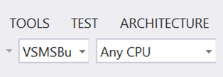
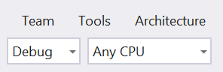
WPF Improvements in .NET 4.6
Performance and reliability improvement on touch stack
Touch events in multi-touch are reported more reliably
Better performance of touch when UI thread is busy
Scrolling and virtualization improvements
Reliable traversal in a list
Preventing layout cycles during virtualization
HDPI Improvements
Multi-dpi cursor and monitor support
Smarter rounding of framework elements
Connect bugs >10 votes reactivated for investigation
4/5 fixed of .NET 4.6 RTM

Slide 7
WPF Tooling in VS 2015
The new Blend for Visual Studio 2015
Integrated with VS technologies like Solution Explorer, Team Explorer, Editor
New Language Service based on “Roslyn”
Faster and more reliable
Code centric workspace in VS, In-place editing support for WPF
Debugging UI Debugging Tools for Xaml, Debugger-Integrated Diagnostic Tools
Diagnostics
Timeline tool

Slide 8
Demo: UI Debugging Tools for XAML

Slide 9
.NET Compiler Platform (“Roslyn”)
C#, VB
Source code
.exe/.dil
IL assemblies
FROM
Isolated/closed compilers
Hard to extend dev experience
Established .NET compilers
Open platform for developers
TO
API: open platform
Rich IDE experiences/refactoring
Code analysis
Custom diagnostics
Open Source compilers
C#, VB
Source code
.exe/.dil
IL assemblies
.NET Compilers Platform
(a.k.a. ROSLYN)

Slide 10
.NET Compiler Platform (“Roslyn”)
Scenarios/usage cases
C#
VB
Language and IDE
New public preview today! (April 2014) http://aka.ms/NETCompilerPlatform
“Roslyn” is the basis for .NET and Visual Studio vNext
“Roslyn” is OPEN SOURCE http://aka.ms/RoslynOSS
API
VS dev experience extensibility
OSS
Open Source

Slide 11
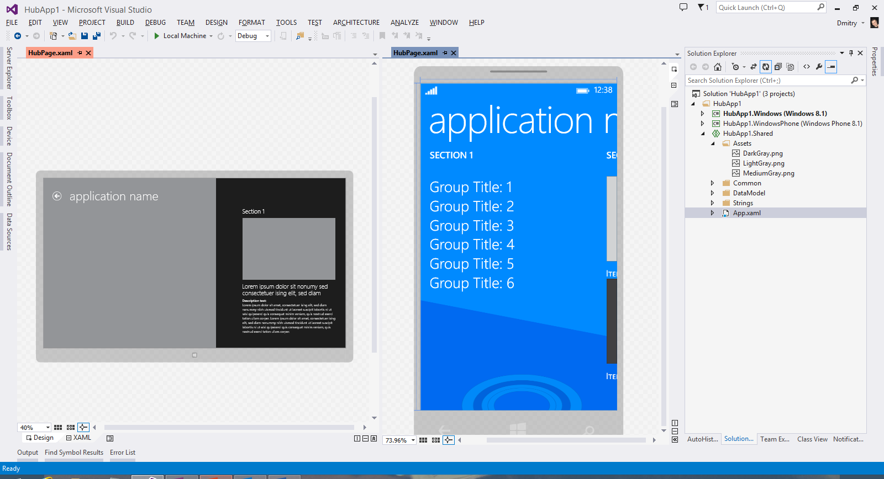

Universal Windows Platform
Universal Windows Platform
Universal Windows Platform
Shared across Windows and Windows Phone apps
.NET Native highlights
Next Generation Compiler in the Cloud for Store Apps
Uses lean runtime and VC++ optimizer for fast code execution and reduced memory usage
Preview available from Visual Studio http://aka.ms/dotnetnative
.NET Native
Native code compilation

Slide 12
Demo: .NET Native

Slide 13


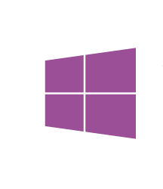
.NET and Xamarin
Share app logic across platforms
Native apps for Windows, iOS and Android devices using .NET
Most productive and powerful platform for creating native applications
Maximize code reuse with Universal Projects & Portable Class Libraries
100% APIs exposed
Everything you can do in xCode or ADT you can do with Visual Studio
z
Native UI
Native UI
Native UI
C# + XIB
C# + AXML
C# + XAML
Shared
client app C# logic
Xamarin
.NET Core

Slide 14
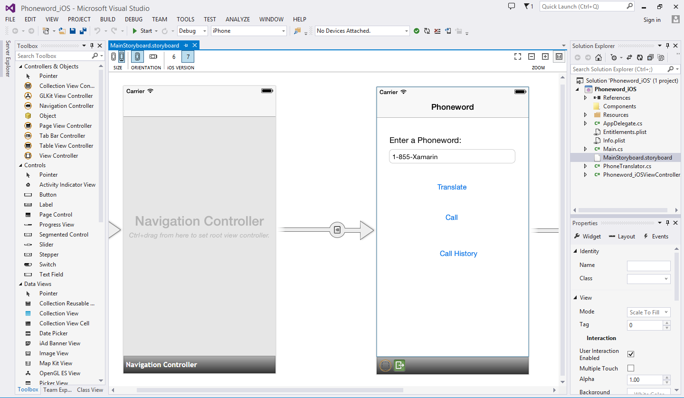
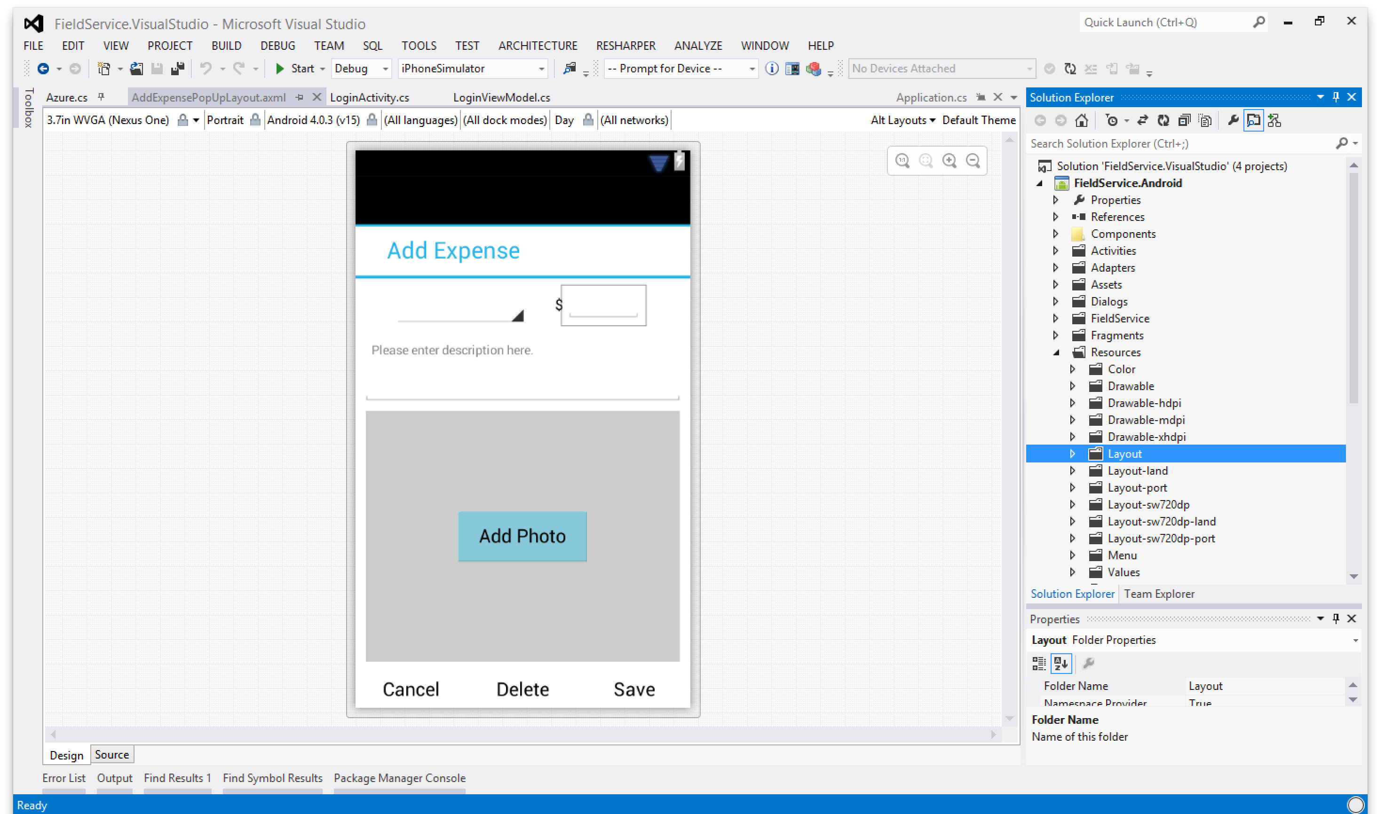
Create UI with drag and drop simplicity
Target multiple screen sizes, resolutions, and OS versions
Layouts saved in native resource formats
Worlds best Android designer available in Visual Studio
iOS in Xamarin 3
UI design in Visual Studio
iOS app designer in Visual Studio
Android app designer in Visual Studio

Slide 15
Demo: .NET and Xamarin

Slide 16
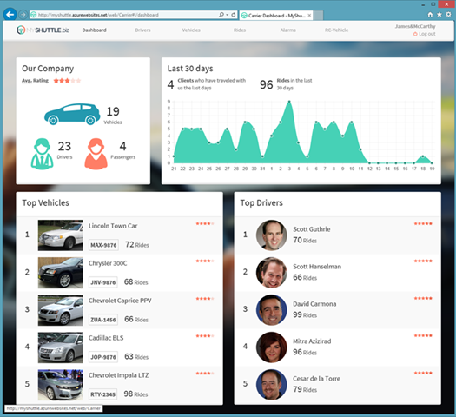
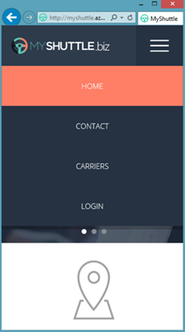
ASP.NET 5.0 / Core 1.0
Cloud-ready
Leaner, faster, simpler
Designed from top to bottom to be ready for the cloud and cross-platform deployments
Modular and open
More flexible with open source and modular implementation
Improved tooling and frameworks
Deliver value faster with improved tooling and frameworks

Slide 17
ASP.NET Core 1.0 - Summary
MVC 6 (MVC + Web API + Web Pages), SignalR 3
Feature | Running on .NET 4.6 | Running on .NET Core 5
Cloud Ready | * | *
Modular Design | * | *
Dependency Injection | * | *
Consistent Tracing / Debugging | * | *
Faster Development (No Build Step) | * | *
Open Source | * | *
Full Side by Side (framework deployed inside application) |  | *
Fast startup, Low memory / High throughput (best of class) |  | *

Slide 18
Demo: ASP.NET 5

Slide 19
.NET Cross-Platform
Services and Web applications
Mobile apps
.NET
Xamarin
Unity
ASP.NET Core 1.0
.NET Core
Windows
Linux
Mac OS X
Mobile Development and .NET/Xamarin partnership
.NET Core cross-platform
Mono

Slide 20
Demo: .NET Core on Linux

Slide 21
.NET Core Preview
Available Now!
.NET Core 1 on Windows
.NET Core 1 on Linux
.NET Core 1 on MacOS

Slide 22

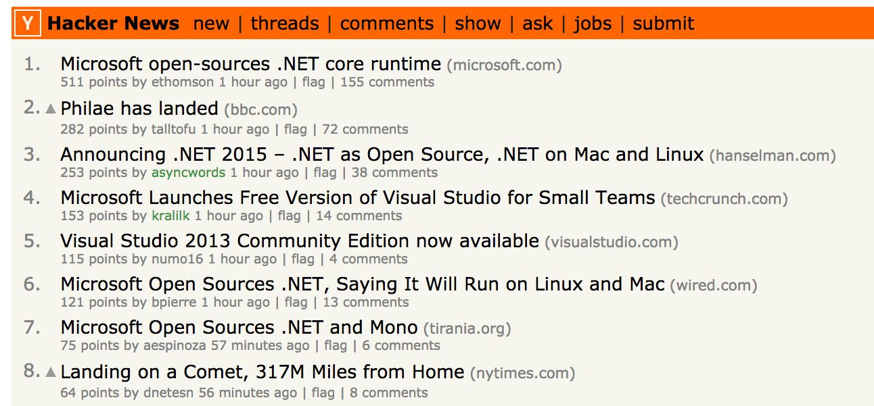

Slide 23
The .NET Foundation
.NET API for Hadoop WebClient
MVVM Light Toolkit
MEF (Managed Extensibility Framework)
.NET Compiler Platform ("Roslyn")
Thinktecture IdentityManager
.NET Map Reduce API for Hadoop
.NET Core 5
ASP.NET 5
WnsRecipe
.NET Micro Framework
MSBuild
Kudu
Cecil
NuGet
ASP.NET Web Pages
Couchbase for .NET
ASP.NET MVC
Xamarin.Mobile
System.Drawing
Openness
Community
Rapid innovation
ASP.NET Web API
Mimekit
Mailkit
Xamarin.Auth
ASP.NET SignalR
Rx (Reactive Extensions)
OWIN Authentication Middleware
Windows Azure .NET SDK
Orchard CMS
Orleans
Salesforce Toolkits for .NET
Join the conversation
http://www.dotnetfoundation.org
@dotnetfdn
Meet the people behind the .NET Foundation
http://www.dotnetfoundation.org/team

Slide 24



Fostering a vibrant .NET ecosystem
dotnetfoundation.org
dotnet.github.io
93 repositories
12,333 forks
2,111 contributors
Growing daily…
Protection
Practices
Visibility
Openness.
Community.
Rapid innovation.
Licenses
Copyrights
Trademarks
Patents
Governance
Mentorship
Support
Feedback
Media
Events
Sponsorship

Slide 25
The road ahead for .NET
ASP.NET 5
.NET Core
.NET Innovation
Open Source
Cross-Platform

Slide 26
Learn More
Session | Title | Day/Time
2-876 | Introducing ASP.NET 5 | Thursday 3:30pm
2-726 | Deep Dive into ASP.NET 5 | Friday 9:00am
2-697 | New XAML Tools in Visual Studio 2015 | Friday 12:30pm
3-670 | Taking .NET Cross-Platform: Building .NET Applications on Linux & Mac | Thursday 2:00pm
3-711 | What’s New in C# 6 and Visual Basic 14 | Friday 9:00am
3-725 | .NET Compiler Platform | Friday 10:30am

